Slide 1



CS 147
AUT 2023
CHECKUP
Hi-fi Prototype
Delali, Angela, Abbie, Susan

Slide 2


CHECKUP
Care On Your Calendar.

Slide 3




CheckUp Team
Susan Lee
Delali Bruce
Angela Mao
Abbie Maemoto

Slide 4
Problem
Solution
Too many students and working adults forgo seeking routine medical care because of friction in finding and scheduling that care.
CheckUp is a digital assistant that seamlessly syncs with your calendar and recommends care that fits right into your schedule.

Slide 5


Roadmap
01
Heuristic Evaluation Results
02
UI Revisions
03
Prototype Status
04
Demo

Slide 6

Heuristic Evaluation
Overview
  1-2 severity violations: 19
  3-4 severity violations: 14
  Most violated heuristics
    Consistency and standards
    Efficiency of use
    Minimalist design

Slide 7

Severity 3-4
Violations
Authentication Flow
  Only scanning insurance is allowed, need to allow for manual entry
Scheduling Flow
  Lack of back buttons in the flow
  Atypical home screen layout
  Chatbot-only scheduling
  Lack of confirmation after clicking choice of doctor
  UI is very crowded in the screen frame, leading to certain things being cut off
Appointment Follow-Ups Flow
  No indication of progress or time elapsed to complete rescheduling task

Slide 8
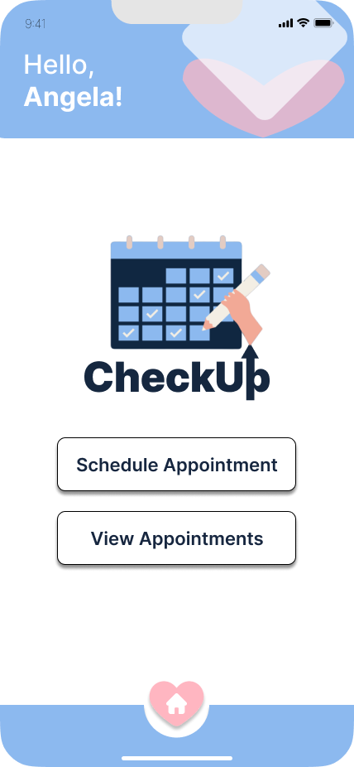
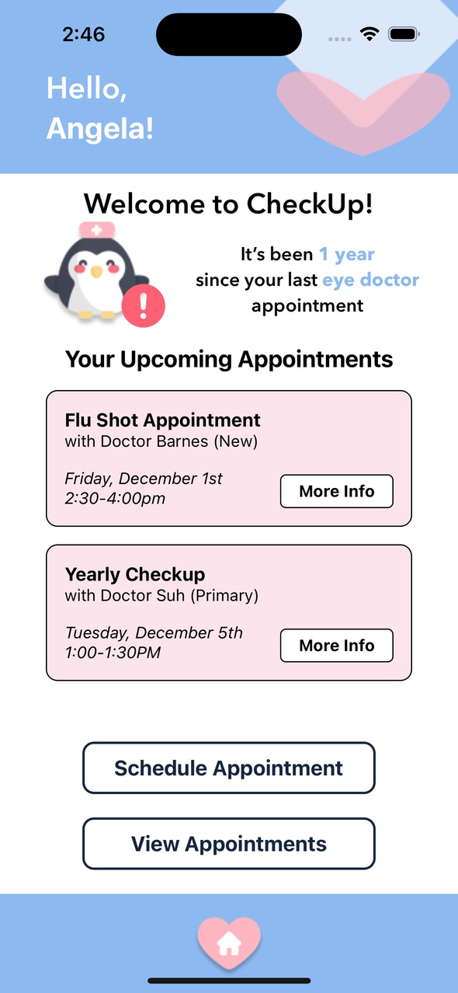
Before
After
Increasing Functionality of the Home Screen
Rationale:
Our original home page design violated H4, H7, and H8 because of the lack of functionalities provided by the home page. Logos and buttons were made unnecessarily large, taking up space that could be used for more useful functionalities.
Revision #1
Progress:
To address the above issues we included:
  previews of upcoming appointments
  reminder feature when the user is due for an appointment
  smaller logo & buttons

Slide 9
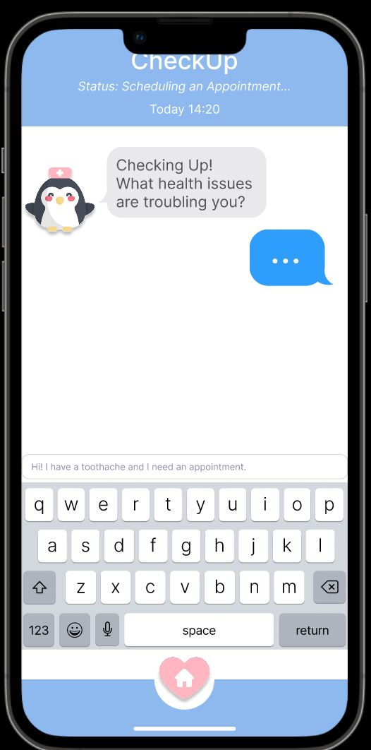
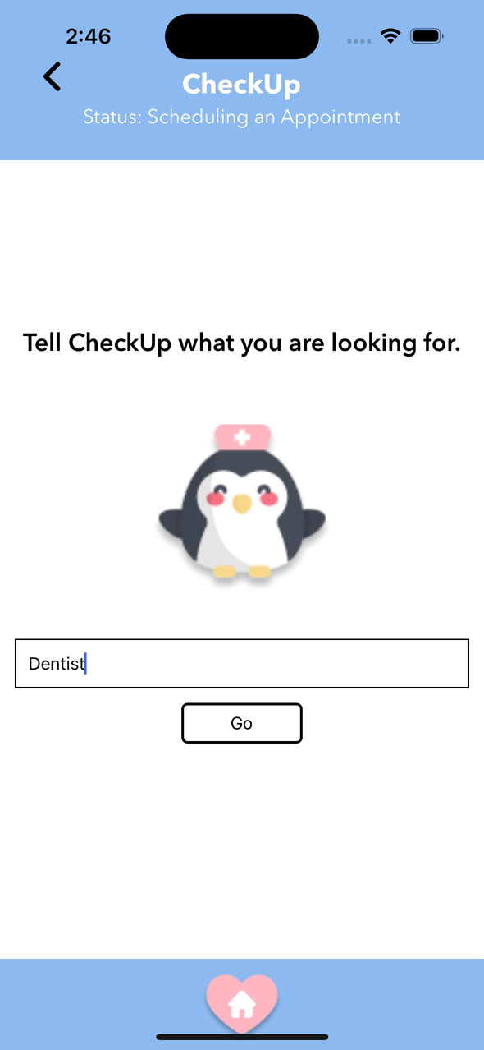
Before
After
Greater Flexibility in Scheduling an Appointment
Rationale:
Our original chatbot feature violated H7 because we only offered one way to schedule an appointment. This workflow of interacting with a chatbot for scheduling is time-intensive and potentially bothersome for those who already know the type of care they need.
Revision #2
Progress:
To address the above issues we included another scheduling option offering a more direct way to search for care. We implemented a search feature in which users can directly find the care they want.

Slide 10
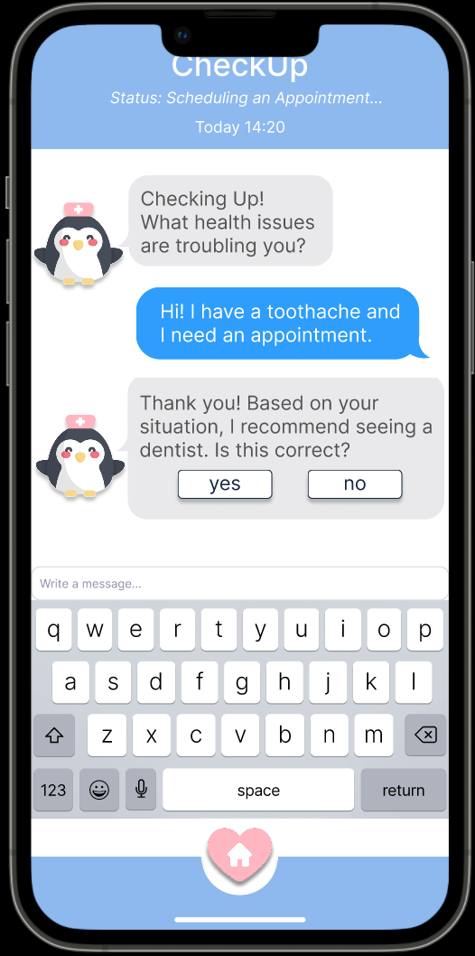
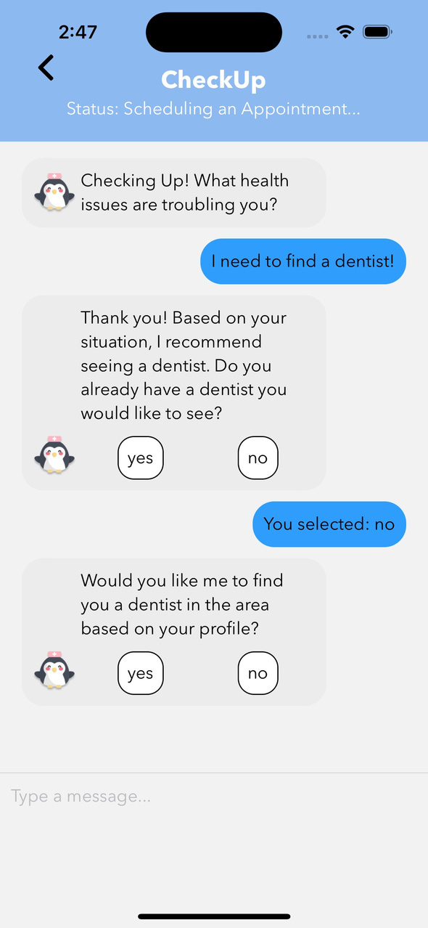
Before
After
Greater User Autonomy in Choice of Doctor
Rationale:
Our original chatbot feature violated H7 because we forced users to search for a doctor every time they needed to schedule an appointment. This did not account for the case where a new user already has a primary doctor.
Revision #3
Progress:
To address the above issue, we added an additional layer to the chatbot which inquires about an existing primary doctor. Once the chatbot identifies the type of care the patient needs, the chatbot determines if the patient already has a primary doctor for the visit.

Slide 11
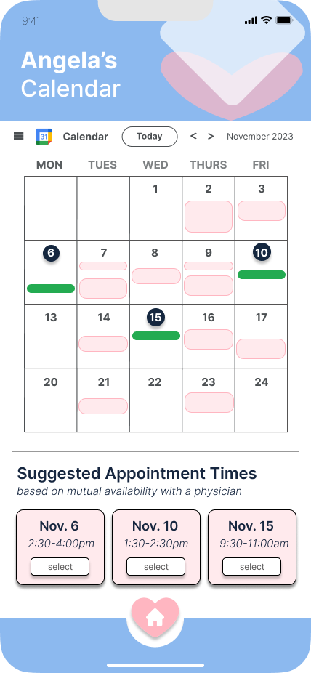
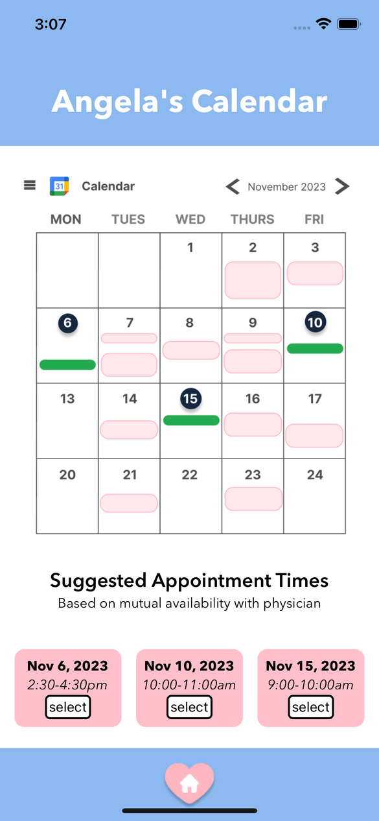
Before
After
Button Accessibility
Rationale:
Our original app had many pages in which the buttons were visibly inaccessible (i.e. too small), violating H7 and 11 . This was especially noted on our calendar page.
Revision #4
Progress:
We addressed these violations by making the month toggle buttons larger, allowing the feature to be more visibly accessible. This is especially important for users with visual impairments.

Slide 12
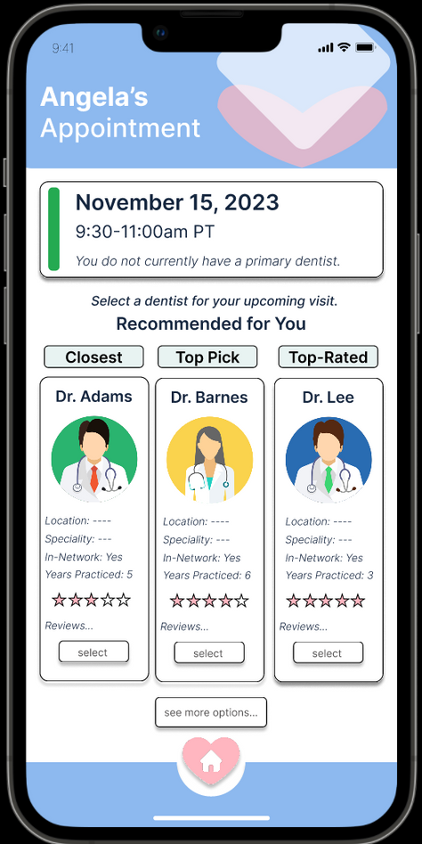
Before
After
Consistency of Appointment Dates and Times
Rationale:
Our original app’s scheduling workflow had inconsistencies in the dates and times across different pages, violating H1. The scheduling workflow is a core task, and consistency in dates and times is a critical part in allowing the user to confirm an appointment.
Revision #5
Progress:
We addressed these violations by ensuring dates and times remained consistent across all pages in the scheduling workflow, increasing user confidence and reducing confusion.

Slide 13
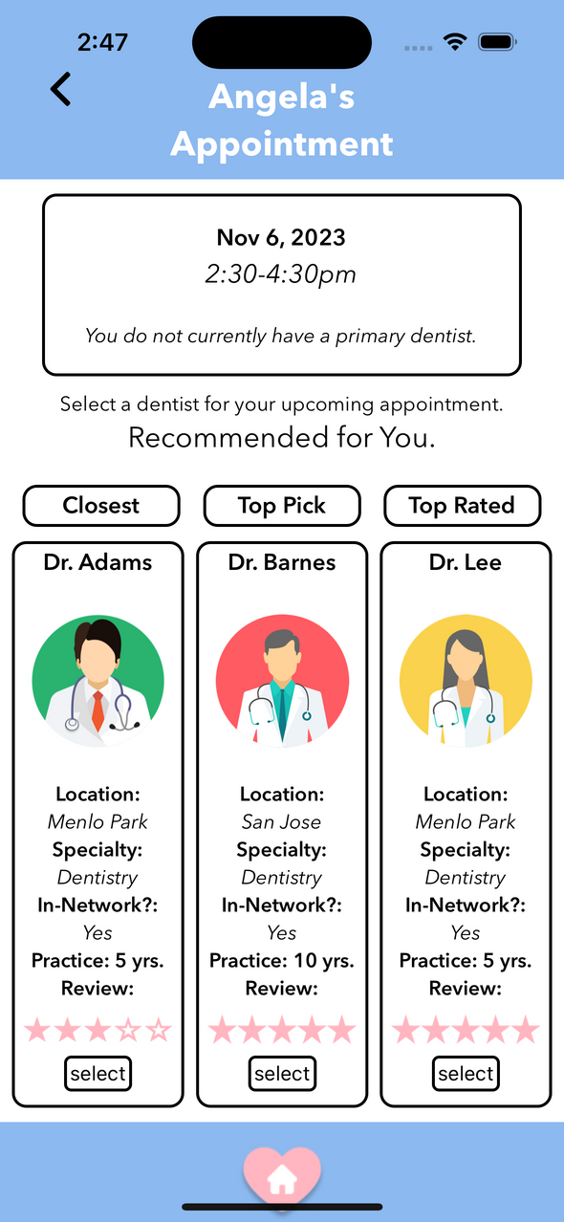
Before
After
User Control in Error Recovery
Rationale:
Our original app’s scheduling workflow did not allow the user to recover from misclicks, violating H3. A misclick in this case causes a significant burden to the user (requires going back to the Home and rescheduling the appointment).
Revision #6
Progress:
We addressed these violations by adding back buttons to appointment booking pages (calendar and doctor recommendations). Our next step is to implement confirmation pages that will act as a second line of defense to user errors.

Slide 14


Revisions & Usability Goals
Ease of Use
Intuitive Interface
Most of our revisions, such as adding options to go back or giving the user to choice to enter their insurance manually, are with the intention to make the UI experience easier for the user
We also aimed to make our app more intuitive by adding in features focused on transparency, such as with the task time being clearly shown to the user

Slide 15
CHECKUP
Prototype Status

Slide 16

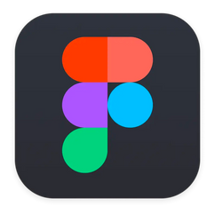



Tools
React Native (Application Framework)
Figma (Design Software)
Supabase (AuthenticationBack-End)
Expo (Software Development Kit)
VSCode (IDE)

Slide 17

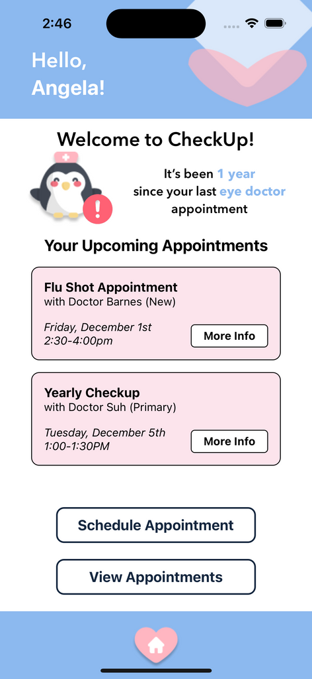
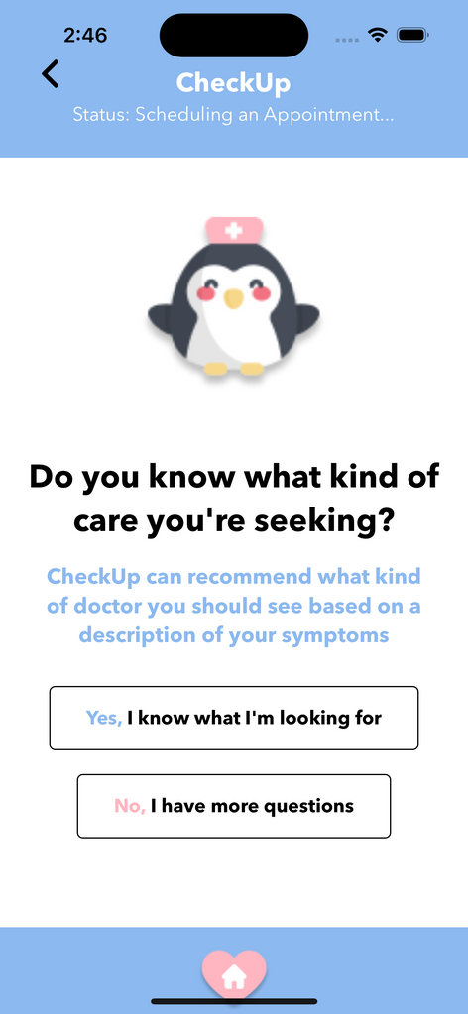
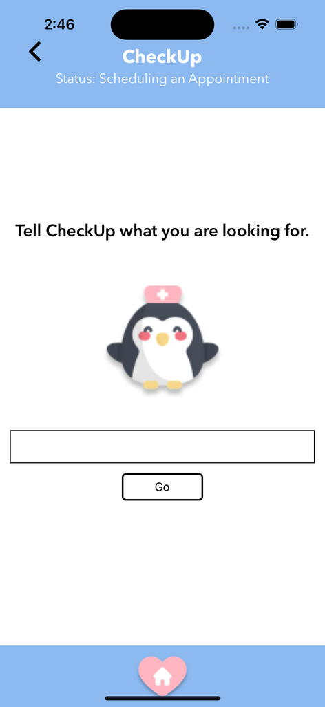
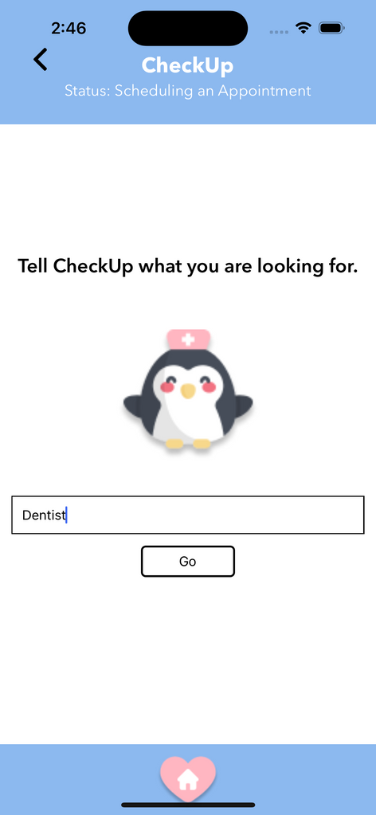
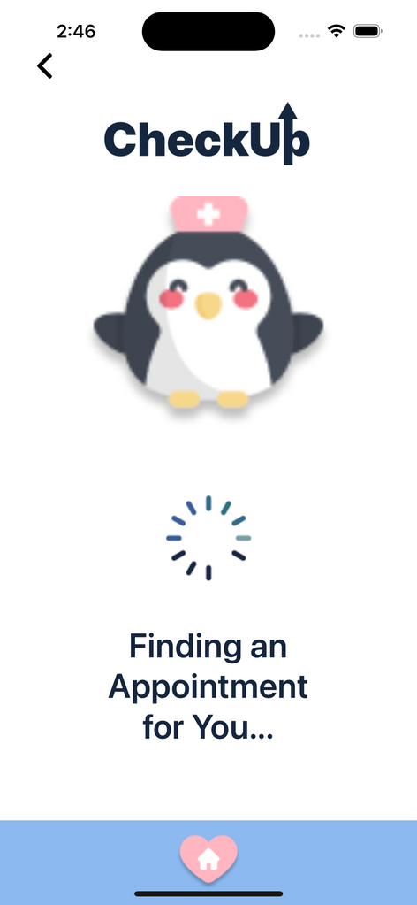

Implemented Features: Task 1
Simple Task: Users can communicate with CheckUp that they want to book an appointment
Option 1: Power users know what care they want.

Slide 18
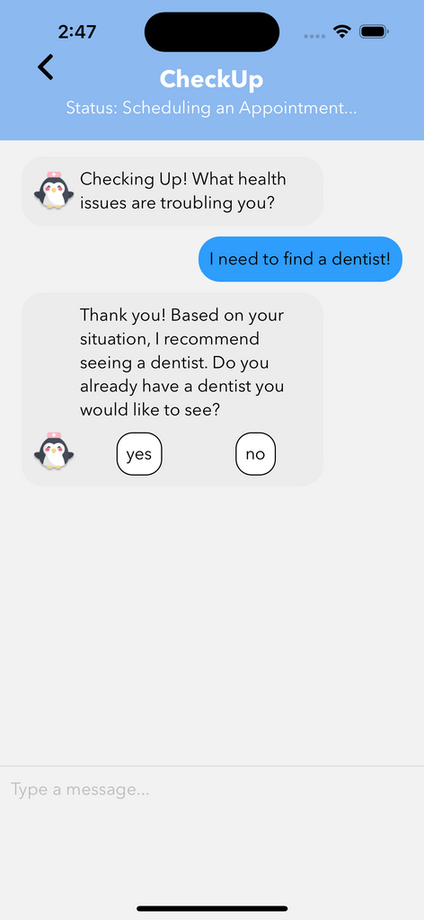
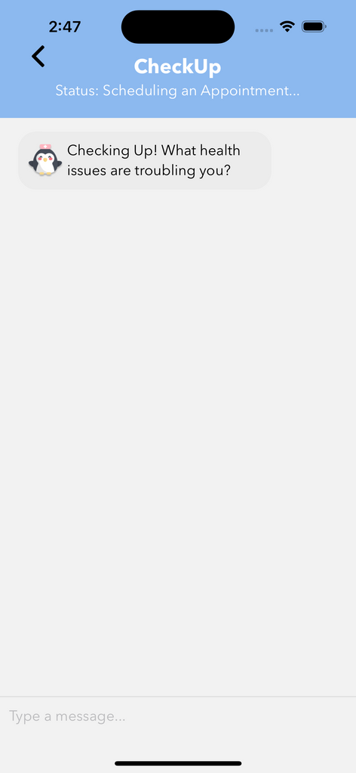

Implemented Features: Task 1
Simple Task: Users can communicate with CheckUp that they want to book an appointment
Option 2: Users want more guidance on the care they need.

Slide 19
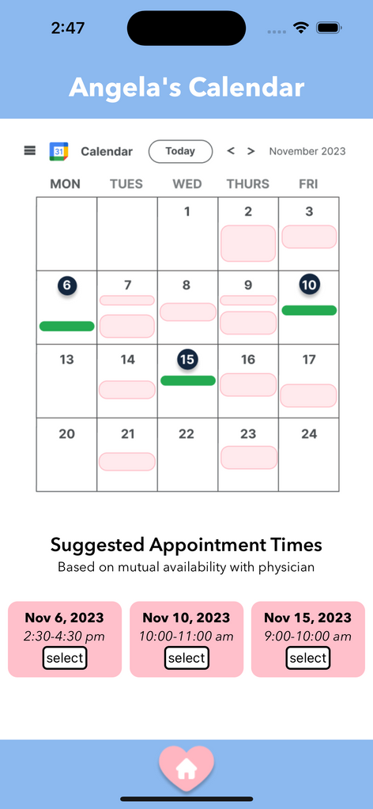
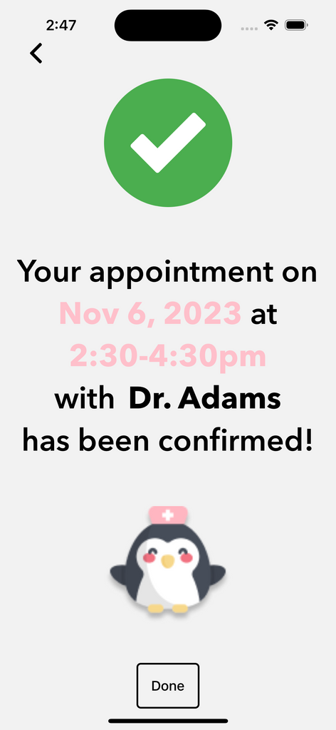
Implemented Features: Task 1
Simple Task: Users can communicate with CheckUp that they want to book an appointment

Slide 20





Unimplemented Features
Setting up calendar integration, insurace card scans, and doctor preferences
Creating an account on CheckUp (authentication)
Canceling/rescheduing appointments
Booking follow-up appointments
Leaving doctor reviews

Slide 21
Our Plans to Finish
1
3
5
Make log-in authentication
Functionality to allow user to see full calendar
Building out checkUp appt + follow up notifcations
2
4
Set up insurance card + calendar task flow
Building out task flow 3 (rescheduling/canceling appts)

Slide 22


Wizard of Oz
Search Function
No matter what the user searches in our search functionality for appointment scheduling, CheckUp “magically” takes them to the next step in the process. The search feature does not actually search the web for information.
Chatbot Feature
No matter what the user types into the chatbot, the interactions are faked using hard-coded chatbot responses. The “magic” chatbot interaction always pushes the user along to the same end point.

Slide 23







Hard Coded Items
Doctor Recommendations
The same three doctors are always the ones recommended
Dates/Time Avaliable
The same three dates are always recommended
Chat Responses
What the chat says/responds with is hard-coded
Home Page Reminder
The same message is always displayed
Upcoming Appointments
The 2 upcoming appointments are always the same

Slide 24

Issues/Questions
  How to set up a user database using Supabase (our backend tool)?
  How to train our chatbot to respond to a variety of user responses correctly?
  Utilizing camera to scan information during log-in / onboarding process
  Getting notifications to pop up on user’s mobile device
  Keeping track of appointment (storing user data)

Slide 25

Prototype Demo

